Slide 1




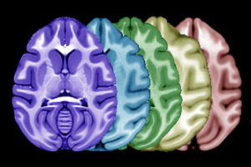
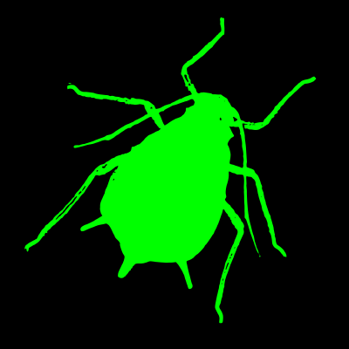
afids-macaca
an extension of the anatomical fiducials protocol to macaques
Github: https://github.com/afids/afids-macaca
Mattermost: ~afids-macaca
Twitter: @afids_project
Previous work in humans:
https://dx.doi.org/10.1002/hbm.24693
http://afids.readthedocs.io

Slide 2
Previous work in humans:
https://dx.doi.org/10.1002/hbm.24693
http://afids.readthedocs.io

Slide 3
MNI2009bSym
BigBrain
Previous work in humans:
https://dx.doi.org/10.1002/hbm.24693
http://afids.readthedocs.io

Slide 4
afids-macaca
an extension of the anatomical fiducials protocol to macaques
Github: https://github.com/afids/afids-macaca
Mattermost: ~afids-macaca
Twitter: @afids_project
Previous work in humans:
https://dx.doi.org/10.1002/hbm.24693
http://afids.readthedocs.io

